Slide 1
Bias / Basic Assumptions

Slide 2
Understanding Bias
Assumptions of parametric tests based on the normal distribution
Know how to correct problems in the data
Notes:
Parametric are those that aim to estimate population parameters… to do so… we have to make assumptions about our sample is a probability sample (mainly that it is normally distributed…). Nonparametric tests are those that aren’t trying to infer anything about the population from the sample, and thus make don’t make assumptions about the population distribution (not based in probability so findings could be grossly wrong with inconsistent errors).

Slide 3
Assumptions
Parametric statistical tests based on the normal distribution assume:
Linearity
Normality
Homogeneity of Variance (Homoskedasticity)
Independence of Observations

Slide 4
But first… Outliers
Outliers bias
parameter estimates
errors associated with parameter estimates

Slide 5
Outliers: Bias in Mean

Slide 6
Outliers: Bias in Error

Slide 7
Linearity
The outcome variable is, in reality, linearly related to any predictors.
Notes:
If you have several predictors then their combined effect is best described by adding their effects together.
Can’t use linear model to explain outcome variable if relationship with predictor is curvilinear

Slide 8
Normality
The errors/residuals in sampling distribution must be normally distributed
Since we don’t have info on sampling distribution, we can assume they are normal if variables are normally distributed
Notes:
Normality assumption only really problem in small samples (since central limit theorem demonstrates that large samples become more normally distributed)
Outliers are more pressing, even if sample is large

Slide 9
Homoscedasticity/Homogeneity of Variance
The variances/spread of scores on an outcome variable is similar across different levels of predictor variables
Notes:
Can do Levene’s Tests
Tests if variances in different groups are the same.
Significant = Variances not equal
Non-Significant = Variances are equal

Slide 10
Homoscedasticity/Homogeneity of Variance

Slide 11
Independence
The errors in your model should not correlate
Accomplished by having independent observations
Notes:
Confidence intervals and significance tests will be invalid if violated.

Slide 12
Assessing Outliers
A biologist was worried about the potential health effects of music festivals.
Download Music Festival
Measured the hygiene of 810 concert-goers over the three days of the festival.
Hygiene was measured using a standardised technique :
Score ranged from 0 to 4
0 = you smell like a corpse rotting up a skunk’s arse
4 = you smell of sweet roses on a fresh spring day

Slide 13
Assessing Outliers (Graphs)

Slide 15
Assessing Normality
Central Limit Theorem
If N > 30, the sampling distribution is normal anyway
Graphical displays
P-P Plot (or Q-Q plot)
Histogram
Values of Skew/Kurtosis
0 in a normal distribution
Convert to z (by dividing value by SE)
Kolmogorov-Smirnov Test
Tests if data differ from a normal distribution
Significant = non-Normal data
Non-Significant = Normal data

Slide 16
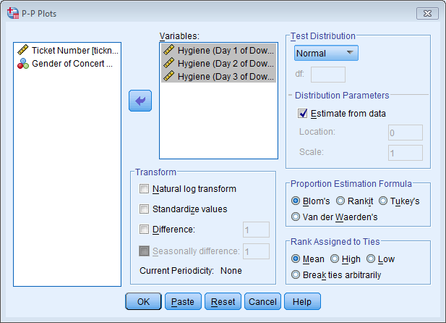
Assessing Normality: The P-P Plot

Slide 17
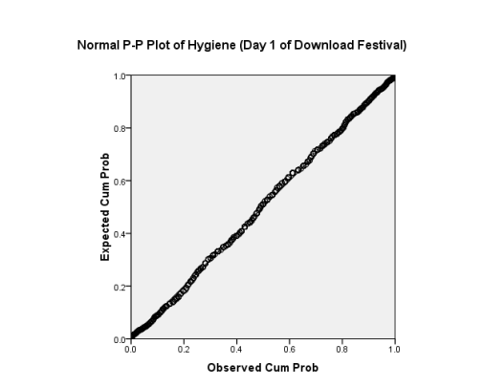
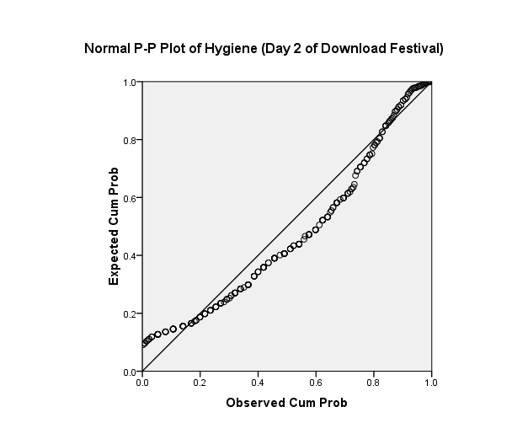
Assessing Normality: The P-P Plot
Normal
Not Normal

Slide 18
Assessing Normality: Skew and Kurtosis

Slide 19
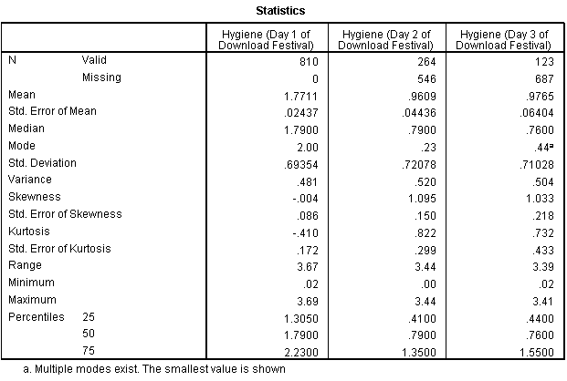
Assessing Normality: Skew and Kurtosis

Slide 20
Assessing Normality: Normality Tests

Slide 21
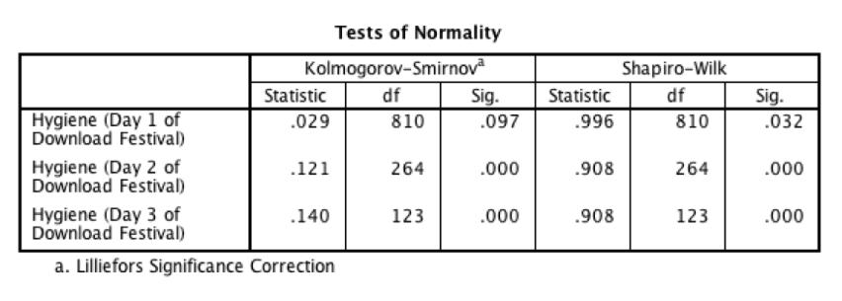
Assessing Normality: Tests of Normality

Slide 22
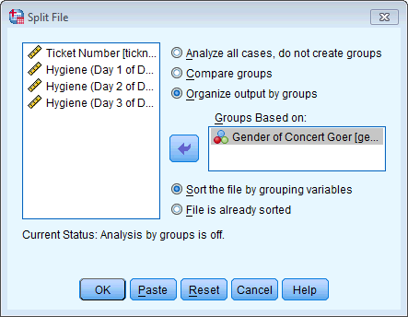
Normality within Groups
The Split File command

Slide 23
Normality within Groups

Slide 24
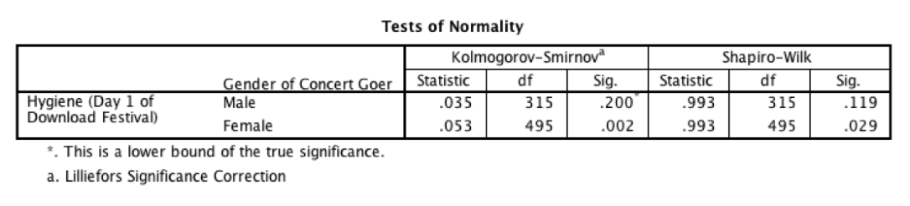
Normality within Groups

Slide 25
Assessing Linearity and Homoscedasticity

Slide 26
Assessing Homoscedasticity/Homogeneity of Variance: Levene’s Test

Slide 27
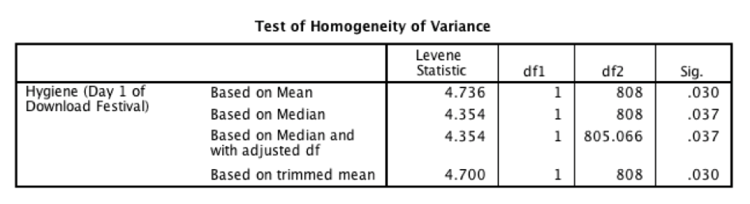
Assessing Homoscedasticity/Homogeneity of Variance: Levene’s Test

Slide 28
Reducing Bias
Trim the data:
Delete a certain amount of scores from the extremes.
Windsorizing:
Substitute outliers with the highest value that isn’t an outlier
Analyse with Robust Methods:
Bootstrapping
Transform the data:
By applying a mathematical function to scores.

Slide 29
Transforming Data
Log Transformation (log(X_{i}))
Reduce positive skew.
Square Root Transformation (√X_{i}):
Also reduces positive skew. Can also be useful for stabilizing variance.
Reciprocal Transformation (1/ X_{i}):
Dividing 1 by each score also reduces the impact of large scores. This transformation reverses the scores, you can avoid this by reversing the scores before the transformation, 1/(X_{Highest} – X_{i}).

Slide 30
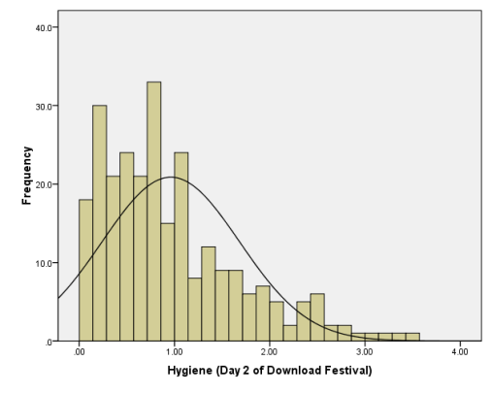
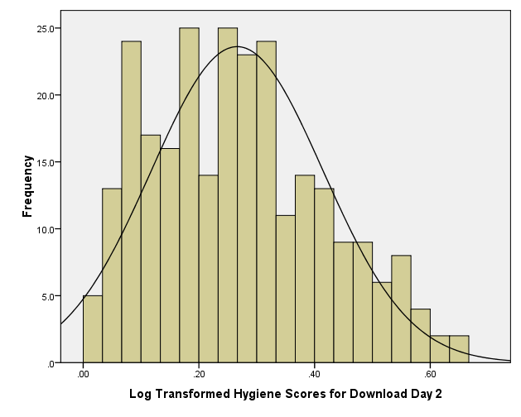
Log Transformation
Before
After

Slide 31
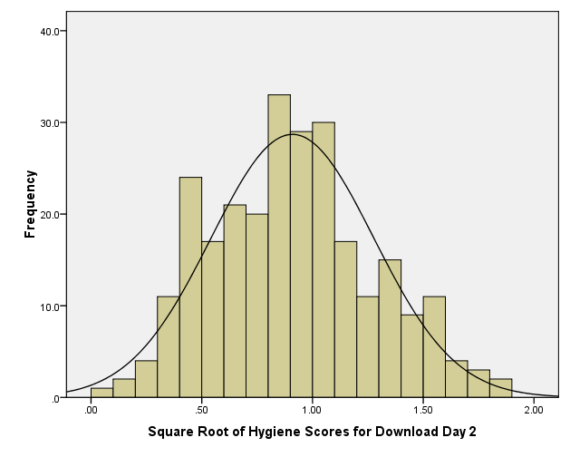
Square Root Transformation
Before
After

Slide 32
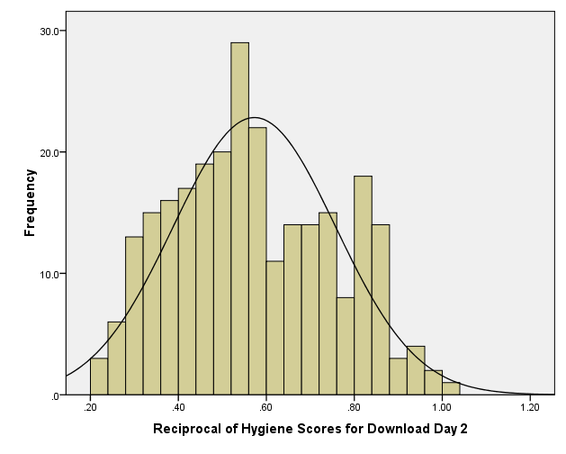
Reciprocal Transformation
Before
After

Slide 33
To Transform … Or Not
Transforming the data changes the hypothesis being tested
E.g. when using a log transformation and comparing means you change from comparing arithmetic means to comparing geometric means
The consequences for the statistical model of applying the ‘wrong’ transformation could be worse than the consequences of analysing the untransformed scores.

